Slide 1
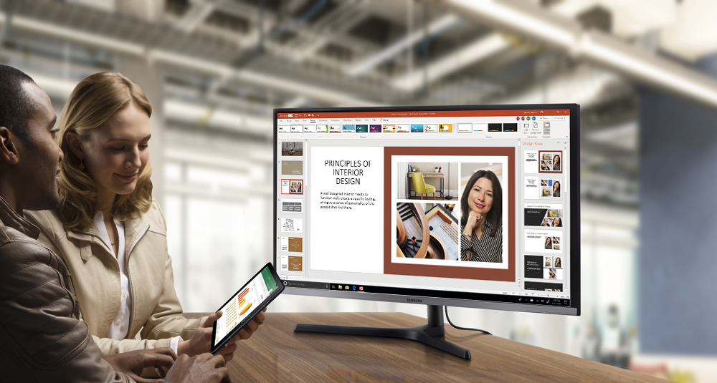


|
Windows Virtual Desktop and Samsung DeX

Slide 2


Slide 3
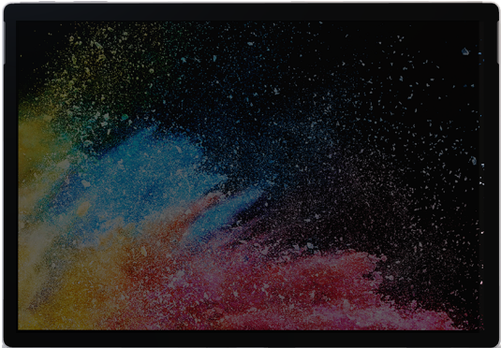

Windows Virtual Desktop
The best virtual desktop experience, delivered on Azure
Windows 10
+
Office 365
Windows
Server
+
Deliver the only multi-session
Windows 10 experience
+
Enable optimizations for
Office 365 ProPlus
+
Migrate Windows Server (RDS)
desktops and apps
+
Deploy and scale in minutes
Notes:
Windows 10 and Office 365—kept up to date, with cloud-connected management powered by ConfigMgr and Intune—provides the most productive and most secure computing experience for users while lowering total cost of ownership and reducing complexity for IT teams
Designed for all customer types, across all segments, Microsoft 365 is the best way for customers to license the products and services necessary to deliver this experience.
Let’s take a look at each of these benefits, starting with productivity and what it means to have the most productive experience.
“…”
Key points to land
Text
Text
Text

Slide 4
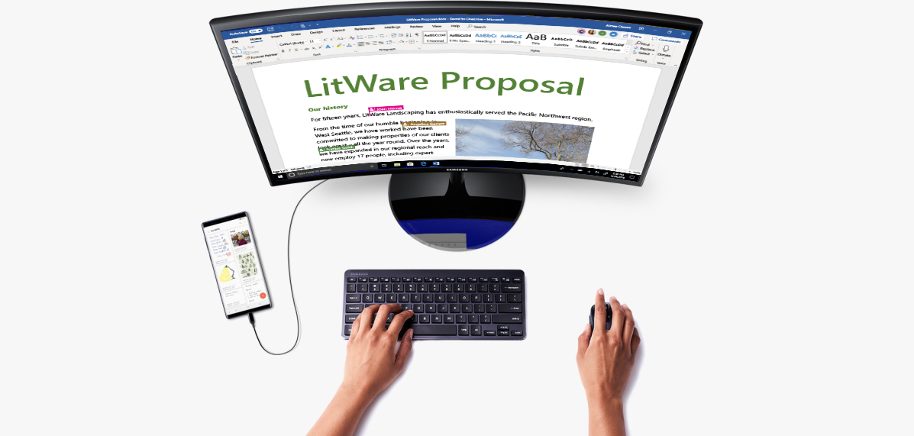
Samsung DeX
PC-like experience entirely powered by Galaxy device
Software that’s built-into Galaxy device that provides PC-like experience (optimized UI)
Connects Galaxy device to a bigger screen, keyboard and mouse
Unifies the mobile and desktop with optimized user experience
Knox security built-in, granular management controls and customizable for your business via Intune
More information on Samsung DeX can be found here

Slide 5
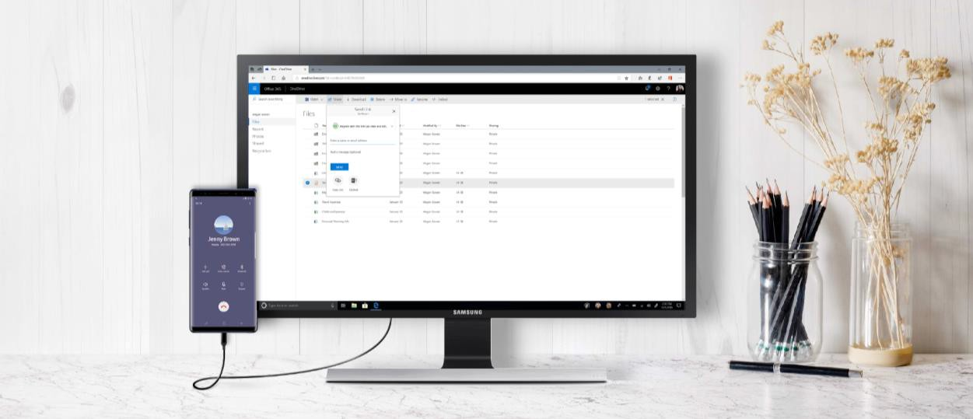
Windows Virtual Desktop with Samsung DeX
Full screen Windows 10 and Office 365 ProPlus experience from Samsung DeX-enabled mobile devices, providing the Windows Virtual Desktop experience on an Android endpoint
Enhanced mobility and productivity with small and big screen experience, allowing customers to seamlessly switch from one application to another
Faster speeds and reduced latency with the new Samsung Galaxy S10 support for 5G and Wi-Fi 6

Slide 6





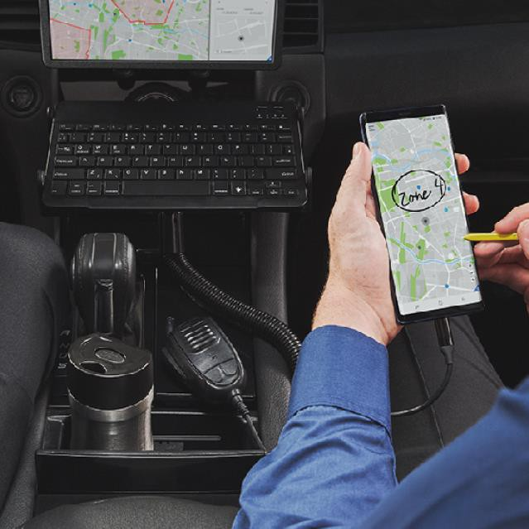
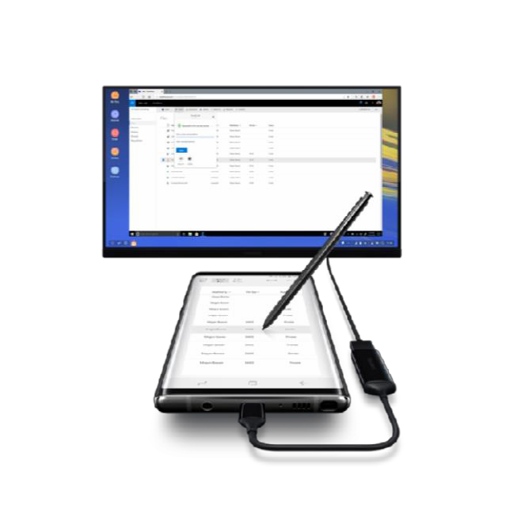
Ultimate convergence of mobility, productivity and security
Windows Virtual Desktop with Samsung DeX
Mobile first
Unique device platform for the highly mobile worker
Flexible productivity
Customer tailored end-user experience and management
Defense grade security
The best defense grade end-to-end mobile security

Slide 7



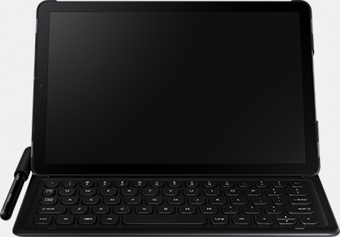
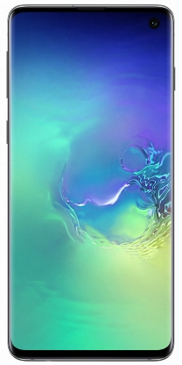
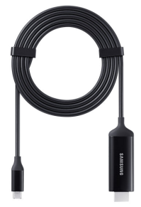
DeX Ready Devices
Galaxy S Series
Galaxy Note Series
Galaxy Tab S Series
Galaxy S10
Most Advanced Network Capability (5G, Wi-Fi 6)
Ultimate Performance
(Improved CPU and GPU, reduced power consumption)
Galaxy Note 9
Optimized for Productivity (Connected S Pen, 12MP+8MP Cameras)
Firstline Worker ready (Water & Dust Resistance (IP68), All Day Battery)
Galaxy Tab S4
Optimized for Customer engagement (Immersive display, 16hr battery)
Productivity on the go (S-Pen, Pogo Keyboard)
Connection thru USB-C

Slide 8
Many customers are already eligible for WVD WVD Licensing Requirements
Client
Customers are eligible to access Windows 10 single and multi session and Windows 7 with Windows Virtual Desktop (WVD) if they have one of the following licenses*:
Microsoft 365 E3/E5
Microsoft 365 A3/A5/Student Use Benefits
Microsoft 365 F1
Microsoft 365 Business
Windows 10 Enterprise E3/E5
Windows 10 Education A3/A5
Windows 10 VDA per user
Server
Customers are eligible to access Server workloads with Windows Virtual Desktop (WVD) if they have one of the following licenses:
RDS CAL license with active Software Assurance (SA)
.
Customers pay for the virtual machines (VMs), storage, and networking consumed when the users are using the service
*Customers can access Windows Virtual Desktop from their non-Windows Pro endpoints if they have a Microsoft 365 E3/E5/F1, Microsoft 365 A3/A5 or Windows 10 VDA per user license.
Notes:
KEY POINTS:
Many Microsoft customers are already eligible for WVD today…
This makes positioning WVD even easier

Slide 9
FSLogix entitlements
Access to FSLogix technology*
FSLogix technology, which improves the performance of Office 365 ProPlus in multi-user virtual environments, is now available at no additional cost for Microsoft 365 customers
Microsoft 365 E3/E5/F1/Business
Microsoft 365 A3/A5/Student Use Benefits
Windows 10 Enterprise E3/E5
Windows 10 Education A3/A5
Windows 10 VDA per user
Remote Desktop Services (RDS) CAL NEW
Remote Desktop Services (RDS) SAL NEW
*Including Office 365 Container, Profile Container, App Masking and Java Redirection

Slide 10
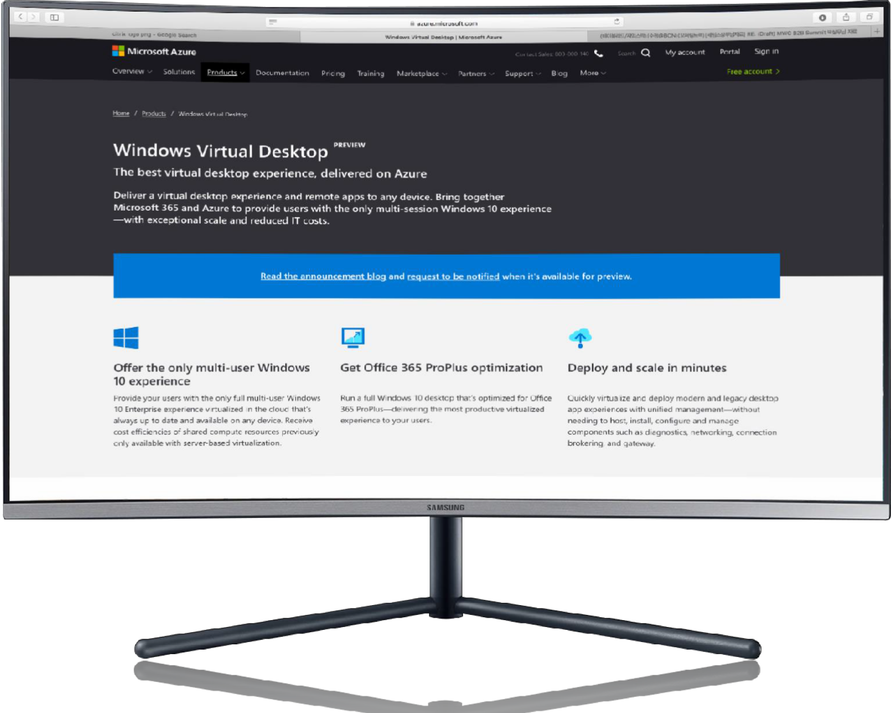
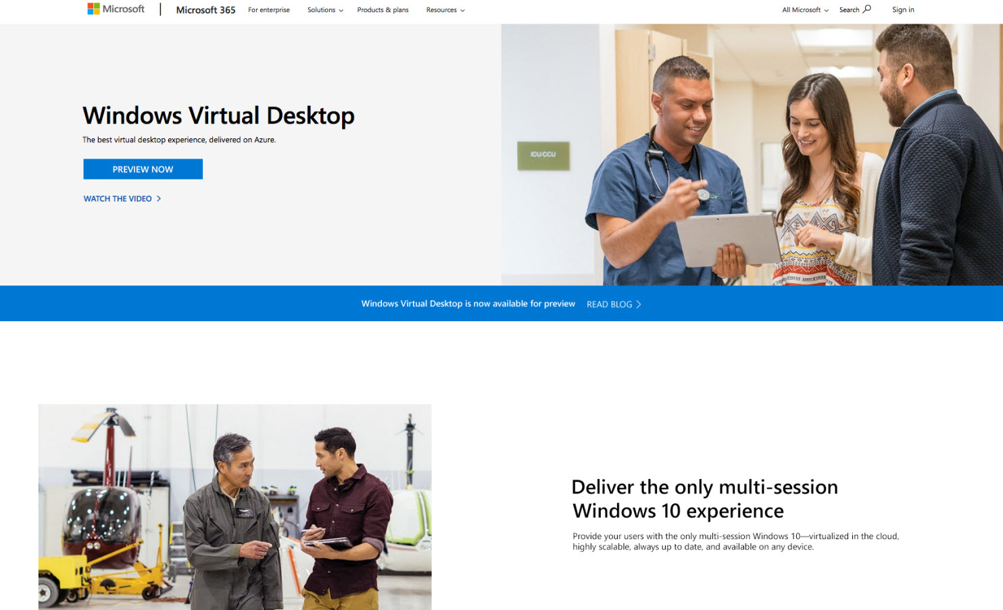


Get started
@aka.ms/wvdpreview

